Slide 1
ACI – Lab Session 2

Slide 2
Genetic Algorithm For N Queens problem

Slide 3
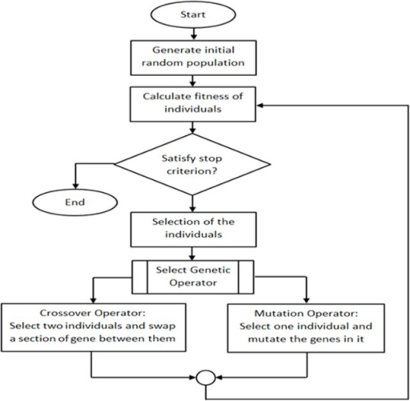
GA - Flowchart

Slide 4
Genetic Algorithm
function GENETIC-ALGORITHM(population, FITNESS-FN) returns an individual
inputs: population, a set of individuals
FITNESS-FN, a function that measures the fitness of an individual
repeat
new population ←empty set
for i = 1 to SIZE(population) do
x ←RANDOM-SELECTION(population, FITNESS-FN)
y ←RANDOM-SELECTION(population, FITNESS-FN)
child ←REPRODUCE(x , y)
if (small random probability) then child ←MUTATE(child )
add child to new population
population ←new population
until some individual is fit enough, or enough time has elapsed
return the best individual in population, according to FITNESS-FN

Slide 5
Genetic Algorithm - Reproduction
function REPRODUCE(x , y) returns an individual
inputs: x , y, parent individuals
n←LENGTH(x );
c←random number from 1 to n
return APPEND(SUBSTRING(x, 1, c), SUBSTRING(y, c + 1, n))
Note: This reproduce function produces a single child

Slide 6
N Queens problem
The eight queens puzzle is the problem of placing eight chess queens on an 8×8 chessboard so that no two queens threaten each other.
The solution requires that no two queens share the same row, column, or diagonal.

Slide 7
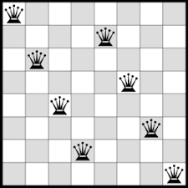
N Queens problem

Slide 8
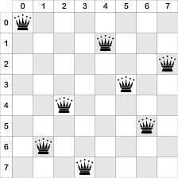
N Queens problem - Representation
The board configuration is represented as (0,4,7,5,2,6,1,3)
Note: Here row indicates the queen number while column indicates the queens position. Vice versa can also be used.

Slide 9
N Queens problem - PEAS
• States: All possible arrangements of n queens (0 ≤ n ≤ 7), one per column in the leftmost n columns, with no queen attacking another.
• Actions: Add a queen to any square in the leftmost empty column such that it is not attacked by any other queen.
The goal of the 8-queens problem is to place eight queens on a chessboard such that no queen attacks any other. (A queen attacks any piece in the same row, column or diagonal.)

Slide 10
GA for n queens - Python
Code Walk through

Slide 11
#Import Libraries and Initialize states
#Import libraries numpy and sys
import numpy as np
import sys
#The initial states -- PEAS
nQueens = 8
STOP_CTR = 28
MUTATE_FLAG = True
MAX_ITER = 10000
POPULATION = None

Slide 12
#Representation of the States - Define class Boardposition
#Define class Boardposition
class BoardPosition:
def __init__(self):
self.sequence = None
self.fitness = None
self.survival = None
def setSequence(self, val):
self.sequence = val
def setFitness(self, fitness):
self.fitness = fitness
def setSurvival(self, val):
self.survival = val
def getAttr(self): return {'sequence': self.sequence, 'fitness': self.fitness, 'survival': self.survival
}

Slide 13
#Calculate fitness of the candidate solution
""" To test for conflicts, we check for
-> row conflicts -> column conflicts -> diagonal conflicts
The ideal case can yield up to 28 arrangements of non attacking pairs (i.e. 28 solutions).
for iteration 0 -> there are 7 non attacking queens
for iteration 1 -> there are 6 non attacking queens ..... and so on
Therefore max fitness = 7 + 6+ 5+4 +3 +2 +1 = 28
Hence fitness value returned will be 28 - <number of clashes> """

Slide 14

#Calculate fitness of the candidate solution - Row and Column clashes
# calculate row and column clashes
# just subtract the unique length of array from total length of array
# E.g. [1,1,1,2,2,2] - [1,2] => 4 clashes
def fitness(chromosome=None):
clashes = 0
row_col_clashes = abs(len(chromosome) - len(np.unique(chromosome)))
clashes += row_col_clashes

Slide 15
#Calculate fitness of the candidate solution
# calculate diagonal clashes
for i in range(len(chromosome)):
for j in range(len(chromosome)):
if (i != j):
dx = abs(i - j)
dy = abs(chromosome[i] - chromosome[j])
if (dx == dy):
clashes += 1
return 28 - clashes

Slide 16
#Chromosome (Candidate solution generation)
def generateChromosome():
# randomly generates a sequence of board states.
global nQueens
init_distribution =)
np.random.shuffle(init_distribution)
return init_distribution
Initially queens are placed in a random positions.

Slide 17
#Generate a population of candidate solutions
def generatePopulation(population_size=100):
global POPULATION
POPULATION = population_size
population = [BoardPosition() for i in range(population_size)]
for i in range(population_size):
population[i].setSequence(generateChromosome())
population[i].setFitness(fitness(population[i].sequence))
summation_fitness = np.sum([x.fitness for x in population])
#Computes the total fitness of the population by summing up the fitness values of all individuals.
#This value is used to normalize fitness scores for calculating survival probabilities.
for each in population:
each.survival = each.fitness / (summation_fitness * 1.0)
#survival probability is calculated
return population

Slide 18
#Get parents for reproduction
def getParent():
globals()
parent1, parent2 = None, None
# parent is decided by random probability of survival.
# since the fitness of each board position is an integer >0,
# we need to normalize the fitness in order to find the solution

Slide 19
#Get parents for reproduction – Parent1
while True:
parent1_random = np.random.rand()
# random value chosen 0 to 1
#parent1_rn contains all the candidate solutions whose survival < parent1_random
parent1_rn = [x for x in population if x.survival <= parent1_random]
try:
#Choose the first element from parent1_rn as the first parent
parent1 = parent1_rn[0]
break
except:
pass

Slide 20
#Get parents for reproduction – Parent2
while True:
parent2_random = np.random.rand()
#parent2_rn contains all the candidate solutions whose survival < parent2_random
parent2_rn = [x for x in population if x.survival <= parent2_random]
try:
#Generate random number from 0 to no. of candidates in parent2_rn
t = np.random.randint(len(parent2_rn))
#Choose the candidate at position t in parent2_rn as parent2
parent2 = parent2_rn[t]
if parent2 != parent1:
break
else:
continue
except:
continue
if parent1 is not None and parent2 is not None:
return parent1, parent2
else:
sys.exit(-1)

Slide 21
#Reproduction - Crossover
def reproduce_crossover(parent1, parent2):
globals()
n = len(parent1.sequence)
c = np.random.randint(0, n) #Random position
child = BoardPosition()
child.sequence = []
#Swap the contents starting from random position
child.sequence.extend(parent1.sequence[0:c])
child.sequence.extend(parent2.sequence[c:])
child.setFitness(fitness(child.sequence))
return child

Slide 22
#Reproduction - Mutation
def mutate(child):
"“” - according to genetic theory, a mutation will take place when there is an anomaly during cross over state
- since a computer cannot determine such anomaly, we can define the probability of developing such a mutation """
if child.survival < MUTATE:
c = np.random.randint(8)
child.sequence[c] = np.random.randint(8)
#print "Inside Mutation"
return child.sequence

Slide 23
#The GA – Calls crossover and mutation for producing new population
def GA(iteration):
print(" #" * 10, "Executing Genetic generation : ", iteration, " #" * 10)
globals()
newpopulation = []
for i in range(len(population)):
parent1, parent2 = getParent()
child = reproduce_crossover(parent1, parent2)
newpopulation.append(child)
summation_fitness = np.sum([x.fitness for x in newpopulation])
for each in newpopulation:
each.survival = each.fitness / (summation_fitness * 1.0)

Slide 24
#The GA – Calls crossover and mutation for producing new population
if (MUTATE_FLAG):
for each in newpopulation:
presentVal = each.sequence
mightBeChangedVal = mutate(each)
if presentVal!=mightBeChangedVal:
each.sequence = presentVal
each.fitness = each.setFitness(fitness(each.sequence))
summation_fitness = np.sum([x.fitness for x in newpopulation])
for each in newpopulation:
each.survival = each.fitness / (summation_fitness * 1.0)
return newpopulation

Slide 25
#The stopping criteria
def stop():
globals()
fitnessvals = [pos.fitness for pos in population]
if STOP_CTR in fitnessvals:
return True
if MAX_ITER == iteration:
return True
return False

Slide 26
#The main iteration of GA
population_size = 100
MUTATE = 1/population_size
population = generatePopulation(population_size)
iteration = 0
while not stop():
# start GA - keep iterating till you find the best position
population = GA(iteration)
iteration += 1
print("Iteration Number: ", iteration)
for each in population:
if each.fitness == 28:
print(each.sequence)

Slide 27
Sample partial output
# # # # # # # # # # Executing Genetic generation : 4293 # # # # # # # # # #
# # # # # # # # # # Executing Genetic generation : 4294 # # # # # # # # # #
# # # # # # # # # # Executing Genetic generation : 4295 # # # # # # # # # #
# # # # # # # # # # Executing Genetic generation : 4296 # # # # # # # # # #
# # # # # # # # # # Executing Genetic generation : 4297 # # # # # # # # # #
# # # # # # # # # # Executing Genetic generation : 4298 # # # # # # # # # #
# # # # # # # # # # Executing Genetic generation : 4299 # # # # # # # # # #
# # # # # # # # # # Executing Genetic generation : 4300 # # # # # # # # # #
# # # # # # # # # # Executing Genetic generation : 4301 # # # # # # # # # #
# # # # # # # # # # Executing Genetic generation : 4302 # # # # # # # # # #
# # # # # # # # # # Executing Genetic generation : 4303 # # # # # # # # # #
# # # # # # # # # # Executing Genetic generation : 4304 # # # # # # # # # #
# # # # # # # # # # Executing Genetic generation : 4305 # # # # # # # # # #
# # # # # # # # # # Executing Genetic generation : 4306 # # # # # # # # # #
# # # # # # # # # # Executing Genetic generation : 4307 # # # # # # # # # # #
# # # # # # # # # Executing Genetic generation : 4308 # # # # # # # # # # #
# # # # # # # # # Executing Genetic generation : 4309 # # # # # # # # # #
Iteration Number: 4310 [1, 4, 6, 0, 2, 7, 5, 3]

Slide 28
Food for thought
Write implementation to solve the problem in Python using Hill climbing algorithm
Change the number of queens for example take the number of queens to be 4, 9, 10, etc. getting the number of queens as input from the user.

Slide 29
